Slide 1


· MCA PROJECT
CAMPUS EVENT MANAGEMENT
& FEEDBACK ANALYZER
CampusConnect
Presented by Puskar Mondal
BWU/MCA/26/047 ·
Master of Computer Applications
Department of Computational Sciences
Notes:
Introduce CampusConnect as a practical MCA project for managing campus events and turning structured records into feedback insight.

Slide 2
MANUAL EVENT COORDINATION CREATES AVOIDABLE FRICTION
Many records
Harder checks
Campus events require coordinated handling of event details, student records, capacity, and feedback.
Manual or separate records make duplicate registrations, seat tracking, student lookup, and feedback analysis harder.
01
THE FRICTION
One response
CampusConnect addresses this with one browser-based interface for core event operations.
Notes:
Start with the operational problem: event details, student records, capacity and feedback become harder to coordinate when they live in separate manual records.

Slide 3
THE WORKFLOW
CAMPUSCONNECT TURNS SCATTERED TASKS INTO ONE WORKFLOW
01
02
03
04
05
Create
Register
Find
Listen
Analyse
CREATE AND MANAGE EVENTS
REGISTER STUDENTS WITH VALIDATION
SEARCH STUDENT INFORMATION AND CANCEL REGISTRATIONS
COLLECT FEEDBACK FROM REGISTERED PARTICIPANTS
ANALYSE RATINGS WITH PANDAS AND VISUALIZE PARTICIPATION WITH MATPLOTLIB
Notes:
Walk left to right through the workflow, from event creation to registration, search and cancellation, feedback collection, and analysis.

Slide 4

IMPLEMENTATION STACK
A LIGHTWEIGHT PYTHON STACK SUPPORTS THE FULL PROTOTYPE
Python · application logic, validation, file handling
Flask · routes, request handling, HTML rendering
HTML + CSS · page structure and interface design
CSV · local tabular storage
Pandas · feedback processing and summary metrics
Matplotlib · event-wise participation charts
Notes:
The prototype stays lightweight: Python and Flask handle the application, HTML and CSS shape the interface, CSV stores records, and Pandas and Matplotlib support analysis and visualization.

Slide 5
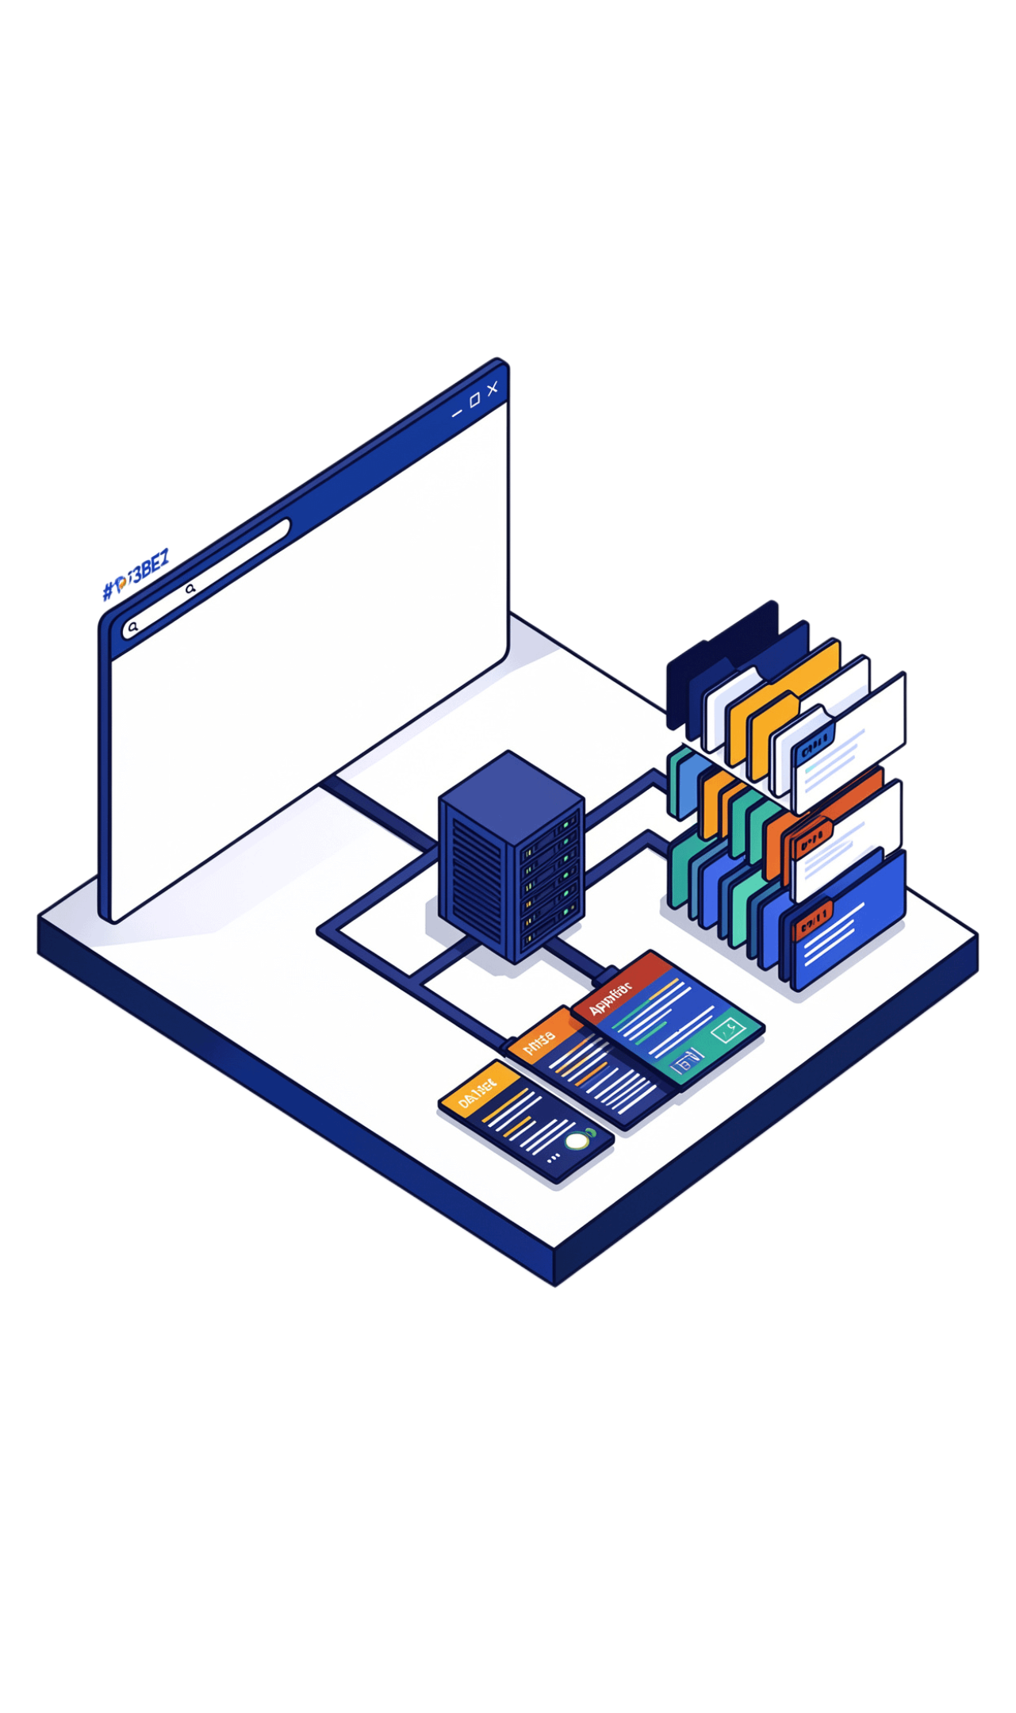

SYSTEM ARCHITECTURE
THREE LAYERS CONNECT THE USER EXPERIENCE TO ANALYSIS
PRESENTATION LAYER
Web browser, HTML, CSS
APPLICATION LAYER
Python, Flask routes, validation
DATA STORAGE LAYER
events.csv, students.csv, registrations.csv, feedback.csv
Notes:
Explain the architecture as a path from user interaction to results. The presentation layer receives input, the application layer validates it, and the storage layer preserves records for analysis.

Slide 6





MODULE MAP
SEVEN MODULES COVER THE CAMPUS EVENT LIFECYCLE
01 Event Management
02 Student Registration
03 Student Search
04 Registration Cancellation
05 Feedback Management
06 Feedback Analysis
07 Graphical Visualization
Notes:
The modules follow the lifecycle from operations to insight: manage the event, work with registrations, collect feedback, analyse it, and visualize participation.

Slide 7
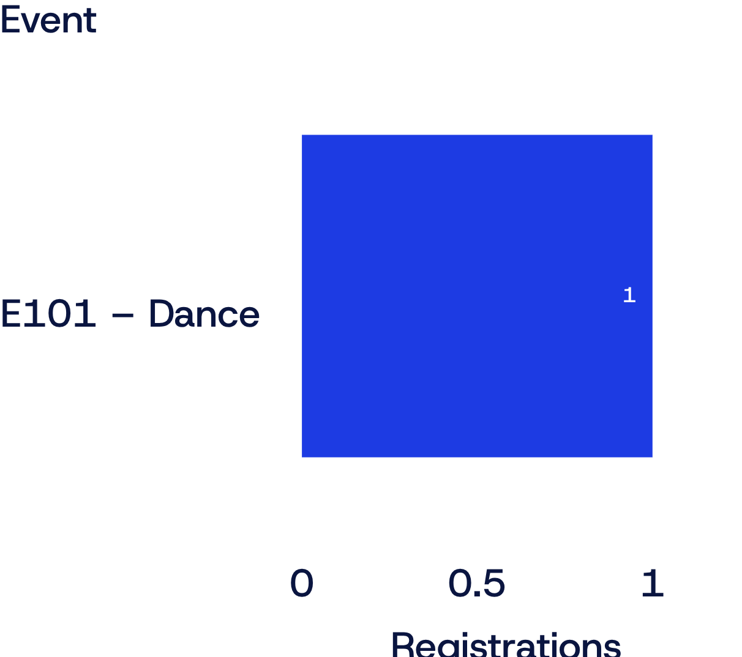
FROM RECORDS TO INSIGHT
Sample event-wise participation
CSV RECORDS BECOME FEEDBACK INSIGHT
CSV file | Records
events.csv | event ID, name, date, venue, capacity
students.csv | student ID, name, email, department
registrations.csv | student–event relationships
feedback.csv | student ID, event ID, rating
Sample run: one registration for E101, giving a one-bar participation view without implying broader performance.
Pandas calculates average ratings and feedback counts; Matplotlib turns event-wise registrations into a bar chart.
Notes:
Records remain simple and inspectable in CSV files. Pandas turns feedback into summary measures, while Matplotlib provides the event-wise participation view shown here.

Slide 8
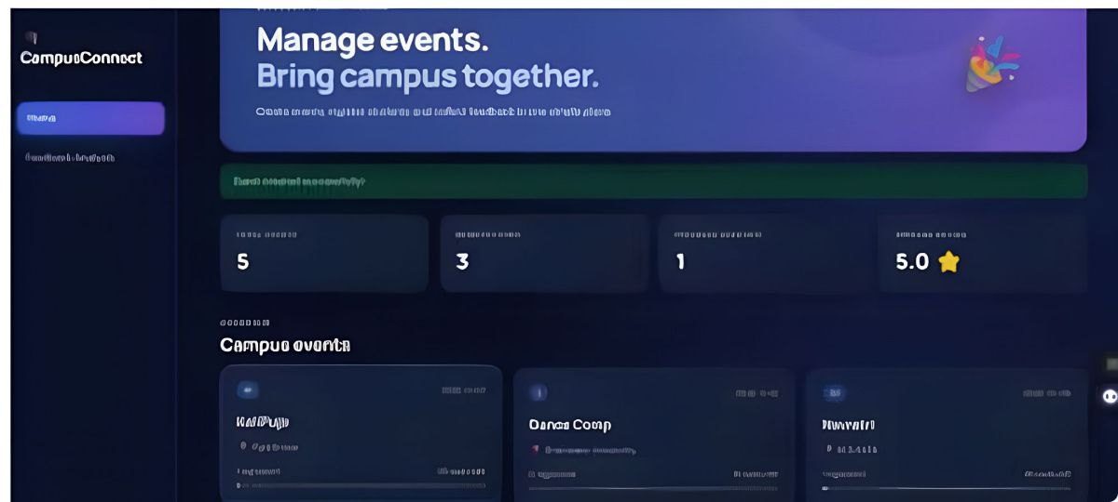
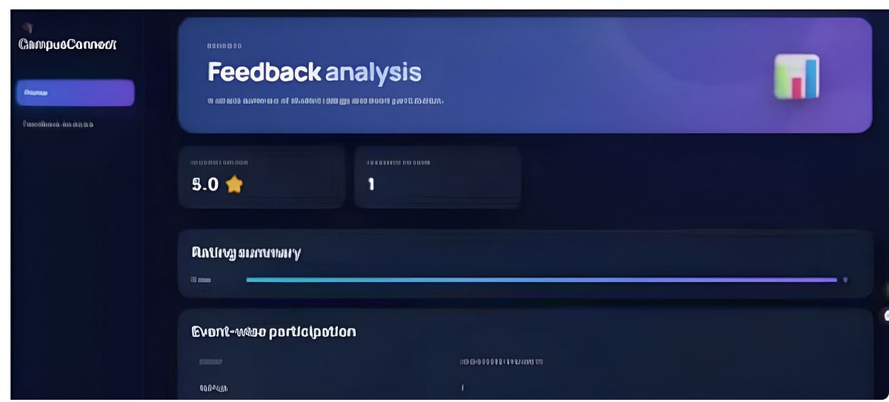
SAMPLE RUN
THE SAMPLE RUN DEMONSTRATES THE CORE USE CASES
Event creation: E101 — Dance · Main Hall · maximum participants 2
Student registration: S101 — Puskar · CSE · registered for E101
Dashboard and event operations
Feedback: rating 5 after registration validation
Analysis output: average rating 5.0 · feedback entries 1
Feedback analysis output
Notes:
Use the screenshots to ground the walkthrough. The sample run creates E101, registers S101, records rating 5, and produces an average rating of 5.0 from 1 feedback entry.

Slide 9
VALIDATION & SCOPE
VALIDATION IS STRONG FOR A SMALL ACADEMIC PROTOTYPE
Testing
Limitations
Future Scope
Event creation, duplicate event ID prevention, registration validation, capacity checking, search, cancellation, duplicate feedback prevention, analysis, and chart generation.
CSV storage, no authentication or role-based access, small-scale academic use, local execution.
MySQL integration, login, admin/student dashboards, cloud deployment, email notifications, advanced feedback analysis
Notes:
Frame the result accurately: the prototype is well tested for its intended academic scope, while CSV storage, local execution, and the absence of authentication define its current limits.

Slide 10

PROJECT TAKEAWAY
CAMPUSCONNECT DEMONSTRATES A PRACTICAL PATH FROM RECORDS TO INSIGHT
Centralizes campus event creation, registration, cancellation, and feedback; maintains structured records through CSV-backed modules.
Applies Pandas for feedback analysis and Matplotlib for participation visualization; demonstrates practical Python and Flask development in an MCA project context.
Notes:
Close by connecting the project’s practical value to its technical implementation: centralized operations, structured CSV records, Pandas analysis, Matplotlib visualization, and Python and Flask development.

Slide 11
THANK YOU

